Slide 1
Serverless
Safaa Alnabulsi
Data Science Retreat

Slide 2
Agenda
Theortical info about cloud computing, serverless, aws and lambda
Hands-on labs
AWS Management Console
create a lambda from bluebrin
create a lambda from scratch
AWS Command Line Interface
aws-cli
create a lambda with the cli
create a lambda with the shell scripts
AWS SDK for Python
Boto3
More complex example, create a lambda that use boto3, polly, s3
Intro
setup local env
Notes:
Pytj

Slide 3
What is cloud computing?
on-demand delivery of IT resources
pay-as-you-go pricing
Notes:
Usually you need to run your code/train your model on a server. Instead on owning a data center and servers, some companies like aws, google and microdsoft started renting them to others.

Slide 4
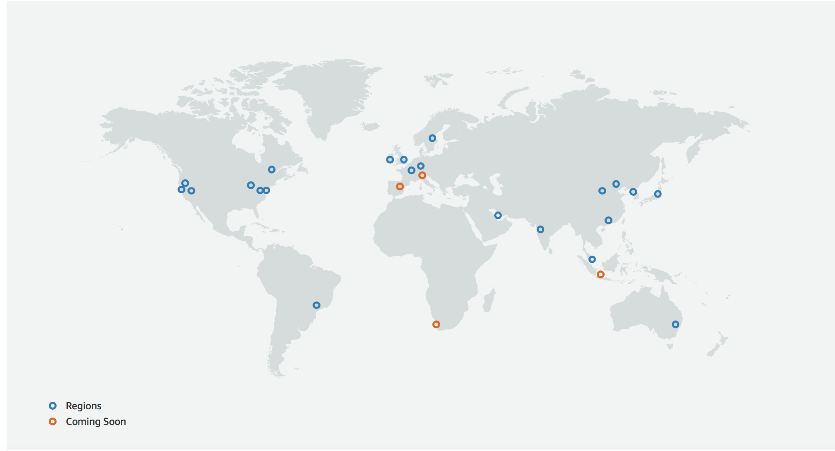
Regions
https://aws.amazon.com/about-aws/global-infrastructure/
Notes:
22 launched regions
#4 announced regions
#69 az

Slide 5
Inside the Data center

Slide 6
What is serverless?
No severs to provision or manage
Scale based on your usage
Only pay for what you use
Built-in availabilty
Notes:
Serverless allows you to build and run applications and services without thinking about servers.
It eliminates infrastructure management tasks such as server or cluster provisioning, patching, operating system maintenance, and capacity provisioning.
You can build them for nearly any type of application or backend service, and everything required to run and scale your application with high availability is handled for you.

Slide 7
AWS serverless platform

Slide 8

AWS Lambda
AWS Lambda is a serverless compute service
It runs your code in response to events and automatically manages the underlying compute resources for you.
Extend other AWS services with custom logic

Slide 9




How to use it?
Event is triggered
Lambda Function
AWS service or resource
A call to API Gateway endpoint

Slide 10




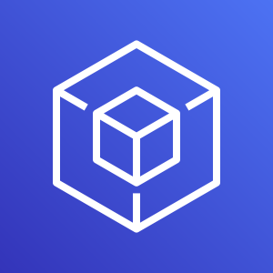




Spoiler Alert …
we will touch today ..
AWS Lambda
AWS Identity and Access Management
AWS Management Console
AWS Command Line
Interface
AWS Tools and SDKs
Amazon CloudWatch
AWS CloudFormation
Amazon Polly
AWS Budgets
Amazon Simple Storage Service

